Slide 1


Mental Health and The Practice of Law:
Professional Health
And Professional Ethics
Eric C. Lang
May 15, 2024
© 2024

Slide 2
Today’s Topics
Is there a mental health crisis in the practice of law?
Obligations regarding
  Those we supervise
  Those we work with
  Those we work for
  Those we work against
The view from the bench
What we can do for ourselves and others

Slide 3
Part 1
Is the Practice of Law in a Mental Health Crisis

Slide 4
Who Are We Talking About?
Isolated Anxiety / Panic
Frequent Anxiety / Panic
Isolated Depression or Mania
Frequent Depression and/or Mania
Disabling Conditions
“Any” “Serious”
17%
5%
78%
No mental illness:
Reactions to stressors that do not impact life other than in the moment.

Slide 5
Look Who’s Talking
Paid Consultants
Concerned Volunteers
Connected Volunteers
Those Who Live It

Slide 6
What Are They Saying to You?
Addressing the Lawyer Suicide Crisis: A Guide for Bar Leaders.
Lawyer Mental Health Crisis: Unveiling 2023 Data, Trends, and Essential Resources for Building Healthier Legal Careers
Mental Health in the Legal Profession: A Crisis, a Case Study and a Call to Action
We Are in a Crisis: Attorney, Judge Suicide Prevention Takes Center Stage in Georgia
Mental health crises plague attorneys along with alcohol abuse
Lawyer Well Being as a Crisis of the Profession.
“The legal industry has the 11th-highest incidence of suicide among professions.”
“Lawyers ranked fourth when the proportion of suicides in that profession is compared to suicides in all other occupations . . .”
“Male lawyers in the United States are two times more likely to commit suicide than men in the general population.”
“Suicide ranks among the leading causes of premature death among lawyers.”

Slide 7


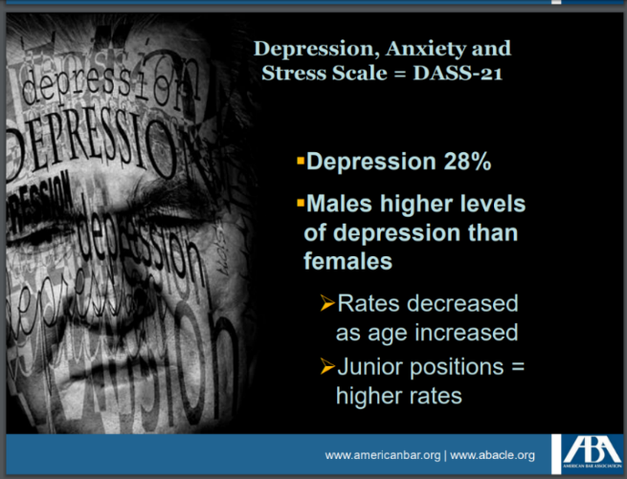


What They Show You

Slide 8
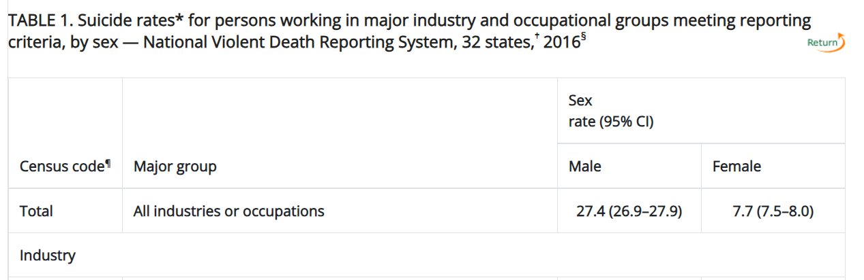
Scary Suicide Statistics???
Most Recent CDC Stats:
© 2020, Eric C. Lang – elang@langlegal.com

Slide 9
Attorney Suicide in Statistical Context
Year | Deaths | States | Adjusted to US | Per 100,000
2016 | 111 | 32 | 174 | 13.25
2015 | 63 | 17 | 186 | 14.3
2012 | 78 | 17 | 230 | 18.47
Year | Attorney Per 100,000 (Blend) | National Per 100,000 | Attorney Per 100,000 (Male) (Rank) | Attorney Per 100,000 (Female) (Rank) | Highest Occupation Per 100,000 (Male) | Highest Occupation Per 100,000 (Female)
2016 | 13.25 | 13.5 | 16.3 (17) | 7.9 (9) | 49.4 (Construction) | 25.5 (Construction)
2015 | 14.30 | 13.3 | 18.7 (14) | 9.2 (5) | 53.2 (Construction) | 15.6 (Arts etc.)
2012 | 18.47 | 12.6 | 21.3 (12) | 11.1 (3) | 43.6 (Construction) | 11.7 (Arts etc.)
Citations: Peterson C, Sussell A, Li J, Schumacher PK, Yeoman K, Stone DM. Suicide Rates by Industry and Occupation — National Violent Death Reporting System, 32 States, 2016. MMWR Morb Mortal Wkly Rep 2020;69:57–62 DOI: http://dx.doi.org/10.15585/mmwr.mm6903a1; Peterson, C., Stone, D.M., Marsh, S.M. & others. (2018). Suicide rates by major occupational group -- 17 states, 2012 and 2015. Morbidity and Mortality Weekly Report. 67(45):1253–1260 DOI: http://dx.doi.org/10.15585/mmwr.mm6745a1; https://www.cdc.gov/nchs/data/databriefs/db464-tables.pdf#1

Slide 10
Part 3
Ethical Responsibilities to and for Other Lawyers

Slide 11
Rule 8.3: Reporting Professional Misconduct
Share:
Maintaining The Integrity of The Profession
(a) A lawyer who knows that another lawyer has committed a violation of the Rules of Professional Conduct that raises a substantial question as to that lawyer's honesty, trustworthiness or fitness as a lawyer in other respects, shall inform the appropriate professional authority.
(b) A lawyer who knows that a judge has committed a violation of applicable rules of judicial conduct that raises a substantial question as to the judge's fitness for office shall inform the appropriate authority.
(c) This Rule does not require disclosure of information otherwise protected by Rule 1.6 or information gained by a lawyer or judge while participating in an approved lawyers assistance program.
Howere some states (GA, WA among them) = should not shall.3

Slide 12
Rule 5.1
(a) A partner in a law firm, and a lawyer who individually or together with other lawyers possesses comparable managerial authority in a law firm, shall make reasonable efforts to ensure that the firm has in effect measures giving reasonable assurance that all lawyers in the firm conform to the Rules of Professional Conduct.
© 2020, Eric C. Lang – elang@langlegal.com

Slide 13
Rule 5.1
(b) A lawyer having direct supervisory authority over another lawyer shall make reasonable efforts to ensure that the other lawyer conforms to the Rules of Professional Conduct.
© 2020, Eric C. Lang – elang@langlegal.com

Slide 14
Rule 5.1
(c) A lawyer shall be responsible for another lawyer's violation of the Rules of Professional Conduct if:
(1) the lawyer orders or, with knowledge of the specific conduct, ratifies the conduct involved; or
(2) the lawyer is a partner or has comparable managerial authority in the law firm in which the other lawyer practices, or has direct supervisory authority over the other lawyer, and knows of the conduct at a time when its consequences can be avoided or mitigated but fails to take reasonable remedial action.
© 2020, Eric C. Lang – elang@langlegal.com

Slide 15
Rule 5.1 – Comment 2
Paragraph (a) requires lawyers with managerial authority within a firm to make reasonable efforts to establish internal policies and procedures designed to provide reasonable assurance that all lawyers in the firm will conform to the Rules of Professional Conduct. Such policies and procedures include those designed to detect and resolve conflicts of interest, identify dates by which actions must be taken in pending matters, account for client funds and property and ensure that inexperienced lawyers are properly supervised.
© 2020, Eric C. Lang – elang@langlegal.com

Slide 16
Rule 5.1 – Comment [3]
Other measures that may be required to fulfill the responsibility prescribed in paragraph (a) can depend on the firm's structure and the nature of its practice. In a small firm of experienced lawyers, informal supervision and periodic review of compliance with the required systems ordinarily will suffice. In a large firm, or in practice situations in which difficult ethical problems frequently arise, more elaborate measures may be necessary. Some firms, for example, have a procedure whereby junior lawyers can make confidential referral of ethical problems directly to a designated senior partner or special committee. See Rule 5.2. Firms, whether large or small, may also rely on continuing legal education in professional ethics. In any event, the ethical atmosphere of a firm can influence the conduct of all its members and the partners may not assume that all lawyers associated with the firm will inevitably conform to the Rules.
© 2020, Eric C. Lang – elang@langlegal.com

Slide 17
Rule 5.2
(a) A lawyer is bound by the Rules of Professional Conduct notwithstanding that the lawyer acted at the direction of another person.
(b) A subordinate lawyer does not violate the Rules of Professional Conduct if that lawyer acts in accordance with a supervisory lawyer's reasonable resolution of an arguable question of professional duty.
© 2020, Eric C. Lang – elang@langlegal.com

Slide 18
Formal Opinion 03-429, June 11, 2003
OBLIGATIONS WITH RESPECT TO
A MENTALLY IMPAIRED LAWYER
IN THE FIRM
© 2020, Eric C. Lang – elang@langlegal.com

Slide 19
Formal Opinion 03-429, June 11, 2003
Mental impairment known to firm or supervising attorney.
Duty to prevent violations of rules.
Violations must be reported.
Possible requirement to disclose to client.
Departure does not terminate obligations.

Slide 20
Formal Opinion 03-431, August 8, 2003
DUTY TO REPORT RULE VIOLATIONS
BY ANOTHER WHO MAY
SUFFER FROM DISABILITY
OR IMPAIRMENT
© 2020, Eric C. Lang – elang@langlegal.com

Slide 21
Formal Opinion 03-431, August 8, 2003
Belief that another lawyer’s mental condition impairs ability to represent clients.
Potential that other lawyer is or may be representing clients.
Belief that a violation raises questions of mental fitness.
Must report.
© 2020, Eric C. Lang – elang@langlegal.com

Slide 22
Rule 5.2: Responsibilities of a Subordinate Lawyer
A lawyer is bound by the Rules of Professional Conduct notwithstanding that the lawyer acted at the direction of another person.
A subordinate lawyer does not violate the Rules of Professional Conduct if that lawyer acts in accordance with a supervisory lawyer's reasonable resolution of an arguable question of professional duty.
© 2020, Eric C. Lang – elang@langlegal.com

Slide 23
What Do You Do When You Know Opposing Counsel Is (Mentally) Impaired:
Beyond the Obvious
Adapted From
North Carolina State Bar 2003 Formal Ethics Opinion 2

Slide 24
It is “known” that opposing client has psychiatric issues but is still practicing. You know how to push your opponent’s buttons to your client’s advantage. Your client knows this and asks you to pursue a strategy that will get your client one million more dollars in negotiations.
© 2020, Eric C. Lang – elang@langlegal.com

Slide 25
Are you going to do what your client asks (implores, demands, orders) you to do.
© 2020, Eric C. Lang – elang@langlegal.com

Slide 26
Your partner says: 33% of that million goes the firm, do it or write me a check for $333,333.
© 2020, Eric C. Lang – elang@langlegal.com

Slide 27
You hear that the client is “shopping” the case around town, and you know that someone will take the case. Does this change your thinking, if you wouldn’t do it to begin with.
© 2020, Eric C. Lang – elang@langlegal.com

Slide 28
If you wouldn’t do it to begin with, do you generally refuse to “beat” lawyers when your skills are superior?
© 2020, Eric C. Lang – elang@langlegal.com

Slide 29
RULE 1.2: SCOPE OF REPRESENTATION AND ALLOCATION OF AUTHORITY BETWEEN CLIENT AND LAWYER
Rule 1.2(a)(2), a lawyer does not violate the duty to abide by the client's decisions relative to the objectives of the representation, "...by avoiding offensive tactics, or treating with courtesy and consideration all persons involved in the legal process.“
Except this rule is not universal:
Not in ABA Model Rule 1.2
States that have this rule, or one like it, include NC, MA, MI, NH, NY, OH.
© 2020, Eric C. Lang – elang@langlegal.com

Slide 30
Rule 2.15:
Responding to Judicial and Lawyer Misconduct
(A) A judge having knowledge* that another judge has committed a violation of this Code that raises a substantial question regarding the judge’s honesty, trustworthiness, or fitness as a judge in other respects shall inform the appropriate authority.*
(B) A judge having knowledge that a lawyer has committed a violation of the Rules of Professional Conduct that raises a substantial question regarding the lawyer’s honesty, trustworthiness, or fitness as a lawyer in other respects shall inform the appropriate authority.
(C) A judge who receives information indicating a substantial likelihood that another judge has committed a violation of this Code shall take appropriate action.
(D) A judge who receives information indicating a substantial likelihood that a lawyer has committed a violation of the Rules of Professional Conduct shall take appropriate action.

Slide 31
Seeing Mental Illness in Yourself and Others
And Finding Help

Slide 32
Mental Health and The Practice of Law:
Professional Health
And Professional Ethics
Need to communicate “offline?” elang@langlegal.com
404.384.2591
Eric C. Lang
February 21, 2024
© 2024

