Slide 1


Going Beyond Fear
In Addressing
Attorney Mental Health
Eric C. Lang
September 17, 2025
Copyright ©2025

Slide 2
Today’s Topics
Evaluating whether there is a mental health crisis in our profession.
Examining ethical responsibilities concerning our own mental health and that of those who work with us.
How to recognize and address mental health concerns in yourself and others.
Time permitting, hypotheticals and questions.

Slide 3

(Does It Matter If)
There Is An
Attorney Mental Health Crisis

Slide 4

When Did Being A Lawyer Get To Be So Hard?
“The thing you are doing is not right; you will surely wear yourself out, and these people as well. For the task is too heavy for you; you cannot do it alone.”
-- Exodus 18:17-18

Slide 5
Seventy-Five Years Ago …
Your lawyer in practice spends a considerable part of his life doing distasteful things for disagreeable people who must be satisfied, against an impossible time limit and with hourly interruptions, from other disagreeable people who want to derail the train; and for his blood, sweat, and tears he receives in the end a few unkind words to the effect that it might have been done better, and a protest at the size of his fee. There is no lawyer who has not at some time in his life rebelled inwardly against all this, and wished that God had assigned him to the peaceful existence of a digger of ditches or a master plumber.
Prosser, Lighthouse No Good, 1 J. Legal Educ. 257 (1948)
© 2020, Eric C. Lang – elang@langlegal.com

Slide 6
Mental Disorder – A Practical Framework
Behavior (significantly) out of place in the environment.
That is involuntary.
And is not a reasonable reaction to an outside stimulation.

Slide 7

Out of Place Behavior
Added Facts
Intentional
Stimulated
Family in horrible car crash.
Con artist.
Well, I woke up that way.
No.
Yes.
Yes.
No.
No.
No.
Notes:
WHY I ACCEPT MY DIAGNOSIS: (a) meds work and (b) “normal thoughts every day”

Slide 8
Who Are We Talking About?
Isolated Anxiety / Panic
Frequent Anxiety / Panic
Isolated Depression or Mania
Frequent Depression and/or Mania
Disabling Conditions
“Any” “Serious”
17%
5%
78%
No mental illness:
Reactions to stressors that do not impact life other than in the moment.

Slide 9
Who Is Doing The Talking?
Paid Consultants
Concerned Volunteers
Connected Volunteers
Those Who Live It

Slide 10
What Are They Saying?
Addressing the Lawyer Suicide Crisis: A Guide for Bar Leaders.
Lawyer Mental Health Crisis: Unveiling 2023 Data, Trends, and Essential Resources for Building Healthier Legal Careers
Mental Health in the Legal Profession: A Crisis, a Case Study and a Call to Action
We Are in a Crisis: Attorney, Judge Suicide Prevention Takes Center Stage in Georgia
Mental health crises plague attorneys along with alcohol abuse
Lawyer Well Being as a Crisis of the Profession.
“The legal industry has the 11th-highest incidence of suicide among professions.”
“Lawyers ranked fourth when the proportion of suicides in that profession is compared to suicides in all other occupations . . .”
“Male lawyers in the United States are two times more likely to commit suicide than men in the general population.”
“Suicide ranks among the leading causes of premature death among lawyers.”

Slide 11
Are They Right About Suicide? (No)
 | Male | Female
Lawyers (per 100K) | 20.5 | 8
Average | 32 | 8

Slide 12
Are They Right About Suicide? (No)
 | Male | Female
Legal | 20.5 | 8
All | 32 | 8
TOP TEN
Fishing and hunting workers | 130.6 | 38.6 | Construction laborers
Other extraction workers | 128.7 | 32.9 | Chefs and head cooks
Surveyors, cartographers, etc. | 119.4 | 26.6 | Installation, maintenance, and repair
Derrick, rotary drill, and service unit operators, oil and gas | 116.8 | 25.8 | Massage therapists
Construction laborers | 91 | 25.3 | Construction and extraction
Structural iron and steel workers | 86.1 | 23.8 | Bartenders
Welding, soldering, and brazing workers | 81.9 | 22.8 | Writers and authors
Automotive service technicians and mechanics | 80.6 | 17.9 | Laborers and freight, stock, and material movers, hand
Roofers | 79.9 | 17 | Hairdressers, hairstylists, and cosmetologists
Millwrights | 73.2 | 16.2 | Waiters and waitresses

Slide 13
Are They Right About Suicide? (No)
 | Male | Female
Legal | 20.5 | 8
All | 32 | 8
NON-PHYSICAL OCCUPATIONS
Management | 21.1 | 10.8 | Health practitioner support technologists and technicians††
Life, physical, and social science | 21.9 | 10.9 | Personal care aides
Architecture and engineering | 21.9 | 11.2 | Nursing, psychiatric, and home health aides
Healthcare practitioners and technical | 22 | 11.3 | Registered nurses
Office and administrative support | 23.2 | 11.6 | Protective service
Health practitioner support technologists and technicians | 25 | 12 | Social workers
Sales and related | 25.7 | 12.3 | Food service managers
Registered nurses | 28.4 | 13 | Production workers, all others
Social workers | 29.7 | 14.1 | Arts, design, entertainment, sports, and media

Slide 14

Are They Right Mental Disorders? (No)

Slide 15
SUICIDE

Slide 16
ATTEMPT ATTEMPT ATTEMPT ATTEMPT ATTEMPT
ATTEMPT ATTEMPT ATTEMPT ATTEMPT ATTEMPT
ATTEMPT ATTEMPT SUICIDE ATTEMPT ATTEMPT
ATTEMPT ATTEMPT ATTEMPT ATTEMPT ATTEMPT
ATTEMPT ATTEMPT ATTEMPT ATTEMPT ATTEMPT
24 of 25 suicide attempts fail. www.suicidology.org/Portals/14/docs/Resources/FactSheets/2012datapgsv1d.pdf

Slide 17
ILLNESS ILLNESS ILLNESS ILLNESS ILLNESS ILLNESS ILLNESS ILLNESS ILLNESS ILLNESS ILLNESS ILLNESS ILLNESS ILLNESS ILLNESS
ILLNESS ILLNESS ILLNESS ILLNESS ILLNESS ILLNESS ILLNESS ILLNESS ILLNESS ILLNESS ILLNESS ILLNESS ILLNESS ILLNESS ILLNESS
ILLNESS ILLNESS ILLNESS ILLNESS ILLNESS ILLNESS ILLNESS ILLNESS ILLNESS ILLNESS ILLNESS ILLNESS ILLNESS ILLNESS ILLNESS
ILLNESS ILLNESS ILLNESS ILLNESS ILLNESS ILLNESS ILLNESS ILLNESS ILLNESS ILLNESS ILLNESS ILLNESS ILLNESS ILLNESS ILLNESS
ILLNESS ILLNESS ILLNESS ILLNESS ILLNESS ILLNESS ILLNESS ILLNESS ILLNESS ILLNESS ILLNESS ILLNESS ILLNESS ILLNESS ILLNESS
ILLNESS ILLNESS ILLNESS ILLNESS ILLNESS ATTEMPT ATTEMPT ATTEMPT ATTEMPT ATTEMPT ILLNESS ILLNESS ILLNESS ILLNESS ILLNESS
ILLNESS ILLNESS ILLNESS ILLNESS ILLNESS ATTEMPT ATTEMPT ATTEMPT ATTEMPT ATTEMPT ILLNESS ILLNESS ILLNESS ILLNESS ILLNESS
ILLNESS ILLNESS ILLNESS ILLNESS ILLNESS ATTEMPT ATTEMPT SUICIDE ATTEMPT ATTEMPT ILLNESS ILLNESS ILLNESS ILLNESS ILLNESS
ILLNESS ILLNESS ILLNESS ILLNESS ILLNESS ATTEMPT ATTEMPT ATTEMPT ATTEMPT ATTEMPT ILLNESS ILLNESS ILLNESS ILLNESS ILLNESS
ILLNESS ILLNESS ILLNESS ILLNESS ILLNESS ATTEMPT ATTEMPT ATTEMPT ATTEMPT ATTEMPT ILLNESS ILLNESS ILLNESS ILLNESS ILLNESS
ILLNESS ILLNESS ILLNESS ILLNESS ILLNESS ILLNESS ILLNESS ILLNESS ILLNESS ILLNESS ILLNESS ILLNESS ILLNESS ILLNESS ILLNESS
ILLNESS ILLNESS ILLNESS ILLNESS ILLNESS ILLNESS ILLNESS ILLNESS ILLNESS ILLNESS ILLNESS ILLNESS ILLNESS ILLNESS ILLNESS
ILLNESS ILLNESS ILLNESS ILLNESS ILLNESS ILLNESS ILLNESS ILLNESS ILLNESS ILLNESS ILLNESS ILLNESS ILLNESS ILLNESS ILLNESS
ILLNESS ILLNESS ILLNESS ILLNESS ILLNESS ILLNESS ILLNESS ILLNESS ILLNESS ILLNESS ILLNESS ILLNESS ILLNESS ILLNESS ILLNESS
ILLNESS ILLNESS ILLNESS ILLNESS ILLNESS ILLNESS ILLNESS ILLNESS ILLNESS ILLNESS ILLNESS ILLNESS ILLNESS ILLNESS ILLNESS
45,000 successful suicides per 9.8 million with serious mental health issues.
https://www.cdc.gov/mentalhealth/learn/

Slide 18
The Rules:
When You Are The Issue

Slide 19
Rule 1.1: Competence
A lawyer shall provide competent representation to a client. Competent representation requires the legal knowledge, skill, thoroughness and preparation reasonably necessary for the representation.
[Comment 8] To maintain the requisite knowledge and skill, a lawyer should keep abreast of changes in the law and its practice, including the benefits and risks associated with relevant technology, engage in continuing study and education and comply with all continuing legal education requirements to which the lawyer is subject.

Slide 20
Rule 1.16
(a) . . . a lawyer shall not represent a client or, where representation has commenced, shall withdraw from the representation of a client if . . .
  (2) the lawyer's physical or mental condition materially impairs the lawyer's ability to represent the client . . .

Slide 21
Mandating Mental Health?
Proposed Comment to Rule 1.1: A lawyer’s mental, emotional, and physical well-being impacts the lawyer’s ability to represent clients and to make responsible choices in the practice of law. Maintaining the mental, emotional, and physical ability necessary for the representation of a client is an important aspect of maintaining competence to practice law.

Slide 22
The Movement Away from
Mandating Mental Health
The American Psychological Association has called for “the removal of mental health questions on applications to practice law,” explaining that “there is no connection between bar application questions about mental health and attorney misconduct and that such questions have not been empirically shown to work as a successful screening tool for who can and cannot practice law in a competent manner.” (August 7, 2023)
Doe v. Supreme Court of Ky., 482 F.Supp.3d 571 (W.D. Ky. 2020)
  “This case is not only about Jane Doe. It's also about the lawyers who decide who else can be a lawyer.”
  “The Bar Bureaucracy won this round against an applicant it deemed suspect and undesirable. But there will be more applicants — and more lawsuits. Some of those plaintiffs will have standing to seek prospective relief. And when they do, the Bar Bureaucracy will have to answer for a medieval approach to mental health that is as cruel as it is counterproductive.”

Slide 23
Perfect Management Model For
Attorneys With Mental Health Disorders
Fantasy
50% Light Stuff: Smaller Matters; Working for Other Lawyers and Their Clients
50% Heavy stuff: Lead Counsel in Large Cases for Direct Clients.
Problem One: Time doesn’t work that way.
Problem Two: The Third 50%
Large case explodes and co-lead-counsel leaves
Personal health problems 1 and 2
Same large case re-explodes
Major health problem family member
Death of other family member
Major health problem yet another family member
RESULT: SYSTEM OVERLOAD

Slide 24

Mental Condition: A Mitigating Factor In Discipline
Under ABA Standard 9.32, Mitigating factors include:
Mental disability . . . when:
there is medical evidence that the respondent is affected by a . . .mental disability;
the . . . mental disability caused the misconduct;
the respondent's recovery from the . . .mental disability is demonstrated by a meaningful and sustained period of successful rehabilitation; and
the recovery arrested the misconduct and recurrence of that misconduct is unlikely

Slide 25
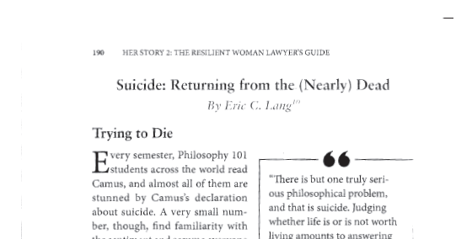

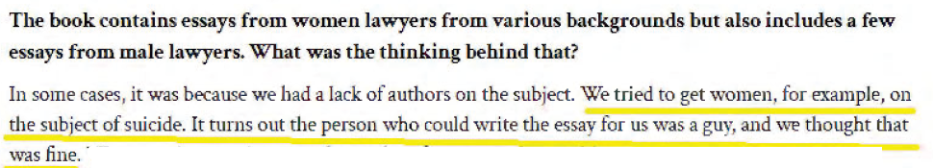

Slide 26
The Rules
When Someone Else Is The Issue

Slide 27
Reporting Ethical Issues
Rule 8.3: A lawyer who knows that another lawyer has committed a violation of the Rules of Professional Conduct that raises a substantial question as to that lawyer's honesty, trustworthiness or fitness as a lawyer in other respects, shall inform the appropriate professional authority.
“Should inform” in these jurisdictions: GA, WA.
  Also in Georgia “There is no disciplinary penalty for a violation of this Rule. “
It is “unless the lawyer reasonably believes that the misconduct has been or will otherwise be reported” in AK

Slide 28
Rule 5.1 – For the Bosses
(a) A partner [or other firm leaders] shall make reasonable efforts to ensure that the firm has in effect measures giving reasonable assurance that all lawyers in the firm conform to the Rules of Professional Conduct.
(b) A lawyer having direct supervisory authority over another lawyer shall make reasonable efforts to ensure that the other lawyer conforms to the Rules of Professional Conduct.
(c) A lawyer shall be responsible for another lawyer's violation of the Rules of Professional Conduct if:
. . . (2) the lawyer is a partner or has comparable managerial authority in the law firm in which the other lawyer practices, or has direct supervisory authority over the other lawyer, and knows of the conduct at a time when its consequences can be avoided or mitigated but fails to take reasonable remedial action.

Slide 29
Rule 5.1 – Comment 2
Paragraph (a) requires lawyers with managerial authority within a firm to make reasonable efforts to establish internal policies and procedures designed to provide reasonable assurance that all lawyers in the firm will conform to the Rules of Professional Conduct. Such policies and procedures include those designed to detect and resolve conflicts of interest, identify dates by which actions must be taken in pending matters, account for client funds and property and ensure that inexperienced lawyers are properly supervised.

Slide 30
Formal Opinion 03-429, June 11, 2003
OBLIGATIONS WITH RESPECT TO A MENTALLY IMPAIRED LAWYER IN THE FIRM
Mental impairment known to firm or supervising attorney.
Duty to prevent violations of rules.
Violations must be reported.
Possible requirement to disclose to client.
Departure does not terminate obligations.

Slide 31
Formal Opinion 03-431, August 8, 2003
DUTY TO REPORT RULE VIOLATIONS
BY ANOTHER WHO MAY SUFFER FROM DISABILITY OR IMPAIRMENT
Belief that another lawyer’s mental condition impairs ability to represent clients.
Potential that other lawyer is or may be representing clients.
Belief that a violation raises questions of mental fitness.
Must report.

Slide 32
Caring About Someone Else

Slide 33
What To Look For - Clinically
Depression:
Depressed mood
Loss of interest or pleasure
Change in appetite or weight
Change in sleeping patterns
Fatigue or loss of energy
Speaking and/or moving with unusual speed or slowness
Feelings of worthlessness or excessive or inappropriate guilt
Diminished ability to think or concentrate, or indecisiveness
Recurrent thoughts of death or suicide
Suicide attempts
Risk of Suicide:
Depression symptoms at a serious level.
Increased alcohol / drug use.
Impulsiveness.
Unnecessary risk taking.
Threats or expressions of suicidal wishes.
Planning, such as giving away possessions or obtaining means.
Unexpected fits of rage or anger.

Slide 34
What To Look For In Others, Really
Not returning phone calls to the clients or opposing counsel;
Not available when clients or opposing counsel attempt to reach at the office;
Not following through in delivering work product requested and promised;
Tends to disappear or vanish for periods of time;
Missed deadline and/or court appearances;
High absenteeism;
Quality changes in communications and writings;
Change in appearance / dress;
Financial stress;
Negative professional outcomes.

Slide 35
What You Can Do
For someone close:
  Be there, which does not mean be there and do things.
  Identify behaviors, not descriptions.
  Offer real steps, not
  platitudes.
If not close, consult others.

Slide 36
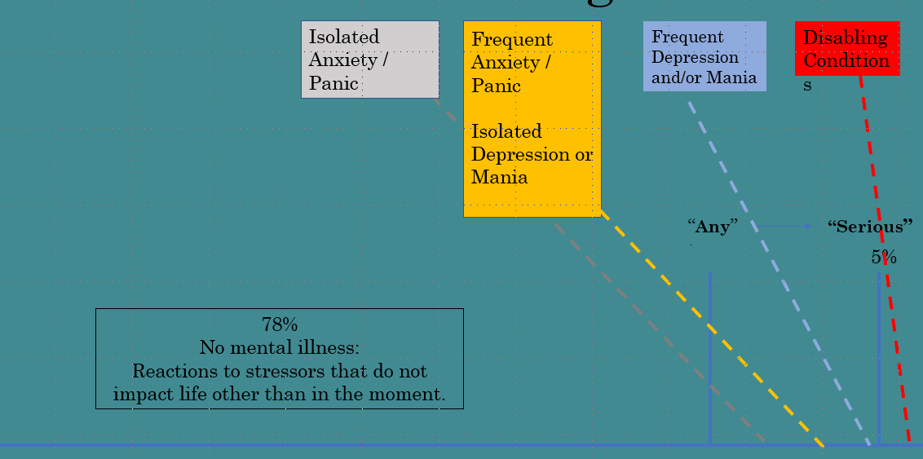
The Current Approach
Lawyer Assistance Programs
Wellness programming
Are we reaching then right audience
vs.

Slide 37
Caring About Yourself

Slide 38
What To Look For In Yourself:
AWARENESS IS THE MOST IMPORTANT TOOL
Are people treating you differently? Avoiding you?
Are there fewer clients?
Fewer social invitations?
Are people asking you if you are OK?
Are you being passed over, left out, etc. for reasons that make no sense to you.
Have objectively bad things happened and not bothered you at all?
When is the last time you did something (which does not include “doing nothing”) that you really like to do?
Are you intently focused on the less important, non-urgent things in life? (For example, how many times have you organized your desk this week?)

Slide 39
Helping Yourself
Know yourself.
Ask others.
Speak to a professional.
And yes, exercise, diet, mindfulness, prayer, meditation and many other things play a role.

Slide 40

Fun Stuff

Slide 41
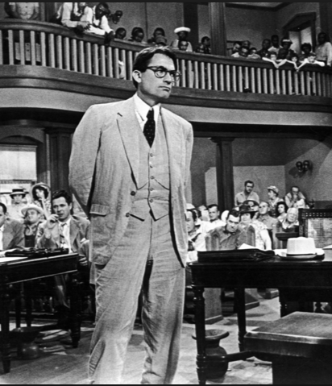
Is this Lawyer a Danger?
Appointed defense counsel, rape case, pushing a “blame the victim” defense. Single father, not around much, children instead interact with potential stalker (ultimately a killer). Tries to keep children out of court but they sneak in. Reputedly very experienced gunman; shoots (to kill) an animal. Defense unsuccessful; convict killed by angry mob.

Slide 42
What Would You Do?
It is “known” that opposing counsel has psychiatric issues but is still practicing. You know how to push your opponent’s buttons to your client’s advantage. Your client knows this and asks you to pursue a strategy that will get your client one million more dollars in negotiations.
Your partner says: 33% of that million goes the firm, do it or write me a check for $333,333.
You hear that the client is “shopping” the case around town, and you know that someone will take the case. Does this change your thinking, if you wouldn’t do it to begin with.
If you wouldn’t do it to begin with, do you generally refuse to “beat” lawyers when your skills are superior?

Slide 43

Is this Lawyer a Danger?
Failed the bar five times. Takes on murder case as first trial. Repeatedly lies to Judge about his legal experience. Makes many procedural errors, costing clients ground in the proceedings. Relies on charm and quick-wittedness and chooses not to actually review the law. Becomes dejected when things go poorly, alienating those close to him. Cycle threatens to repeat itself, as a late-trial “aha” moment reinforces belief that success occurs regardless of preparation, if you are smart enough.

Slide 44
THANK YOU!
If you have follow-up questions or need copies of anything that I have referenced, please let me know.
Eric C. Lang
Lang Legal
elang@langlegal.com
404.384.2591

